Slide 1

Pig and Data Lake
COMP 1702 Big Data
Lecture 8

Slide 2
What is Pig
Pig is a high-level programming language useful for analysing large data sets. Pig was a result of development effort at Yahoo!

Slide 3
Need for High-Level Languages
Hadoop is great for large-data processing!
But writing Java programs for everything is verbose and slow
Not everyone wants to (or can) write Java code
Solution: develop higher-level data processing languages
Hive: HQL is like SQL
Pig: Pig Latin is a bit like Perl

Slide 4


Hive and Pig - 1
Hive: data warehousing application in Hadoop
Query language is HQL, variant of SQL
Tables stored on HDFS as flat files
Developed by Facebook, now open source
Pig: large-scale data processing system
Scripts are written in Pig Latin, a dataflow language
Developed by Yahoo!, now open source
Roughly half of all Yahoo! internal jobs
Common idea:
Provide higher-level language to facilitate large-data processing
Higher-level language “compiles down” to Hadoop jobs

Slide 5
Hive and Pig - 2
Hive and Pig were developed independently by Facebook and Yahoo respectively
HiveSQL is declarative
Pig Latin is procedural
Hive good for structured or semi-structured data
Pig can process both semi-structured and unstructured data
However there is considerable overlap in their capabilities and the choice of which to use is a matter of personal preference to a large extent
But remember although there are some similarities in syntax between Hive and Pig, expressions are not interchangeable

Slide 6














Yahoo! estimates that between 40% and 60% of its Hadoop workloads are generated from Pig Latin scripts.
With 100,000 CPUs at Yahoo! and roughly 50% running Hadoop, that's a lot of pigs running around.
Twitter for processing logs, mining tweet data
AOL and MapQuest for analytics and batch data processing
LinkedIn, where Pig is used to discover people you might know.
Ebay is reportedly using Pig for search optimization.

Slide 7
Example Data Analysis Task
Find the top 10 most visited pages in each category
Visits
Pages
Visits
user | url | time
Amy | www.cnn.com | 8:00
Amy | www.bbc.com | 8:05
Amy | www.myblog.com | 10:00
Amy | www.flickr.com | 10:05
Fred | cnn.com/index.htm | 12:00
URL Info
url | pagerank | category
www.cnn.com | 0.9 | news
www.flickr.com | 0.9 | social media
www.myblog.com | 0.7 | social media
www.bbc.com | 0.2 | news
. . .

Slide 8
Data Flow
Load Visits
Group by url
Foreach url
generate count
Load Url Info
Join on url
Group by category
Foreach category
generate top10 urls

Slide 9
MapReduce Code

Slide 10
In Pig Latin
visits = load ‘visits’ as (user, url, time);
gVisits = group visits by url;
visitCounts = foreach gVisits generate url, count(visits);
urlInfo = load ‘urlInfo’ as (url, category, pRank);
visitCounts = join visitCounts by url, urlInfo by url;
gCategories = group visitCounts by category;
topUrls = foreach gCategories generate top(visitCounts,10);
store topUrls into ‘results/topUrls’;

Slide 11
Java vs. Pig Latin
1/20 the lines of code
1/16 the development time
Performance on par with raw Hadoop!

Slide 12
Pig takes care of…
Schema and type checking
Translating into efficient physical dataflow
(i.e., sequence of one or more MapReduce jobs)
Executing the system-level dataflow
(i.e., running the MapReduce jobs)
Tracking progress, errors, etc.

Slide 13
Compilation into Map-Reduce
Map₁
Every group or join operation forms a map-reduce boundary
Load Visits
Group by url
Reduce₁
Map₂
Foreach url
generate count
Load Url Info
Join on url
Reduce₂
Map₃
Other operations pipelined into map and reduce phases
Group by category
Reduce₃
Foreach category
generate top10(urls)

Slide 14
Components of Pig
Comprised of 3 core parts:
Data types
Input data can be any format
Operates on semi-structured, or unstructured data
Supports complex data types, such as bags and tuples
Data flow language
Expresses requirements as algorithms
Each step is a data transformation
Support for relational operators such as filter, union, group
User defined functions
Provides a way to specify custom processing
Allows Pig to be extensible to process any data type
Can be implemented in Java, Python, JavaScript

Slide 15
Running Pig
Pig Latin commands can be run in three ways:
Grunt interactive shell
Script file
Embedded in Java programs
Each of the above can work in one of two modes
Local mode
This is a development mode
Runs on local filesystem, does not use Hadoop
Provides immediate feedback on Pig scripts
Hadoop MapReduce mode
Used for processing large datasets
Pig script compiled to MapReduce program
Distributed over all nodes in Hadoop cluster

Slide 16
Grunt Shell
Enables execution of Pig Latin statements
Provides basic utility to interact with the HDFS
To run Pig in MapReduce mode type pig at command prompt
this is the default
To run Grunt shell in local mode:
pig –x local
Grunt commands include:
help
quit
set debug [on | off]
cat, cd, cp, ls, mkdir, mv, pwd, rm

Slide 17
Basic Pig Latin
Consider loading data for processing
For example, we will assume we have book data in a books.csv file
data is comma separated (CSV)
ISBN | Title | Author | Year | Publisher | Price
055321215X | Pride and Prejudice | Jane Austen | 1983 | Bantam Books | 4.99
61099686 | Downtown | Anne Rivers Siddons | 1995 | HarperTorch | 10.00
553582909 | Icebound | Dean R. Koontz | 2000 | Bantam Books | 6.99
425182908 | Isle of Dogs | Patricia Cornwell | 2002 | Berkley Publishing Group | 5.50
To load file from within grunt, use the following command:
Result of any LOAD statement is a relation (a set of tuples)
Relations are given names (aliases) so they can be referred to later
alias
grunt> books = LOAD ‘books.csv’ USING PigStorage(‘,’) AS (ISBN:chararray, title:chararray, author:chararray, year:int, publisher:chararray, price:float);

Slide 18
…continued
DUMP command allows data to be printed to the screen. Pig follows a lazy evaluation strategy. No operation is evaluated until the value or the transformed data is required.
grunt> books = LOAD ‘books.csv’ USING PigStorage(‘,’) AS (ISBN:chararray, title:chararray, author:chararray, year:int, publisher:chararray, price:float);
grunt> ten_books = LIMIT books 10;
grunt> DUMP ten_books;
Displays 10 records
DESCRIBE command allows us to see the structure of a relation – that is the relation’s schema
grunt> DESCRIBE books;
books: {ISBN:chararray, title:chararray, author:chararray, year:int, publisher:chararray, price:float}

Slide 19
Processing Data
Consider querying the data set to find how many books each author has published
The Pig Latin script to achieve this is:
grunt> books = LOAD ‘books.csv’ USING PigStorage(‘,’) AS (ISBN:chararray, title:chararray, author:chararray, year:int, publisher:chararray, price:float);
grunt> authors = GROUP books BY author;
grunt> result = FOREACH authors GENERATE author, COUNT(books);
grunt> STORE result INTO ‘results’;
grunt> DUMP result;
This would generate the output:
Write results to file
Jane Austen, 3
Anne Rivers Siddons, 1
Patricia Cornwell, 4
…

Slide 20
FOREACH operator
FOREACH processes every row to generate derived sets of rows, using a GENERATE clause to define the field in each derived row
grunt> books = LOAD ‘books.csv’ USING PigStorage(‘,’) AS (ISBN:chararray, title:chararray, author:chararray, year:int, publisher:chararray, price:float);
grunt> authors = FOREACH books GENERATE author;
grunt> DUMP authors;
Jane Austen
Anne Rivers Siddons
Dean R. Koontz
Patricia Cornwell

Slide 21
FILTER BY Operator
Pig allows you to remove unwanted records based on a condition.
The Filter functionality is similar to the WHERE clause in SQL. The FILTER operator is used to remove unwanted records from the data file.
The syntax of FILTER operator is shown below:
<new relation> = FILTER <relation> BY <condition>
grunt> books = LOAD ‘books.csv’ USING PigStorage(‘,’) AS (ISBN:chararray, title:chararray, author:chararray, year:int, publisher:chararray, price:float);
grunt> filtered_books = FILTER books BY price > 5.00;
grunt> DUMP filtered_books;
61099686 | Downtown | Anne Rivers Siddons | 1995 | HarperTorch | 10.00
553582909 | Icebound | Dean R. Koontz | 2000 | Bantam Books | 6.99
425182908 | Isle of Dogs | Patricia Cornwell | 2002 | Berkley Publishing Group | 5.50

Slide 22
GROUP BY Operator
Similar to SQL GROUP operator
Groups data on a particular key
grunt> books = LOAD ‘books.csv’ USING PigStorage(‘,’) AS (ISBN:chararray, title:chararray, author:chararray, year:int, publisher:chararray, price:float);
grunt> authors = GROUP books BY author;
grunt> DUMP authors;
(Roy,{(9724119378,O Deus Das Pequenas Coisas,Roy,1998)})
(Amy Tan,{(804106304,The Joy Luck Club,Amy Tan,1994)})
(Patricia Cornwell,{(039914739X,Isle of Dogs,Patricia Cornwell,2001,
(380710218,Postmortem,Patricia Daniels Cornwell,1993)})

Slide 23
Relational Operators
It is the relational operators in Pig Latin that provide the real power
Let’s consider a simple example:
file1.txt
file2.txt
0, 1, 2
2, 4, 6
0, 7, 8
1, 9, 10
grunt> a = LOAD ‘file1.txt’ USING PigStorage(‘,’) AS (a1:int, a2:int, a3:int);
grunt> b = LOAD ‘file2.txt’ USING PigStorage(‘,’) AS (b1:int, b2:int, b3:int);
grunt> DUMP a;
(0, 1, 2) (2, 4, 6)
grunt> DUMP b;
(0, 7, 8) (1, 9, 10)
grunt> c = UNION a, b;
grunt> DUMP c;
(0, 1, 2) (2, 4, 6) (0, 7, 8) (1, 9, 10)

Slide 24
User Defined Functions
Pig allows extensibility through User Defined Functions (UDF)
PiggyBank is an online repository of user defined functions
Most UDFs are written in Java
Supplied as a .jar file
To use a UDF, it must be first be registered
Consider using a UDF named UPPER which converts strings to upper case
grunt> a = LOAD ‘stringdata.txt’ USING PigStorage(‘,’) AS (author:chararray, title: chararray);
grunt> REGISTER piggybank.jar;
grunt> DEFINE UPPER org.apache.pig.piggybank.string.UPPER();
grunt> uppercase_data = FOREACH a GENERATE UPPER(title);

Slide 25
Pig Latin Scripts
Scripts enable reuse of Pig Latin
Comments can be added to scripts
Single-line comments begin with a double hyphen - -
Multiple-line comments are enclosed in /* */
Parameters can be passed to the scripts to make them more flexible
Use $parameterName in scripts to access parameters
first_script.pig
/* Simple script that loads input file and dumps first few lines to console.
File name and number of lines to dump are passed to script as parameters*/
books = LOAD ‘$file’ USING PigStorage(‘,’) AS (ISBN:chararray, title:chararray, author:chararray, year:int, publisher:chararray);
limit = LIMIT books $size;
DUMP limit;
To run the script
pig –param file=books.csv –param size=5 first_script.pig

Slide 26
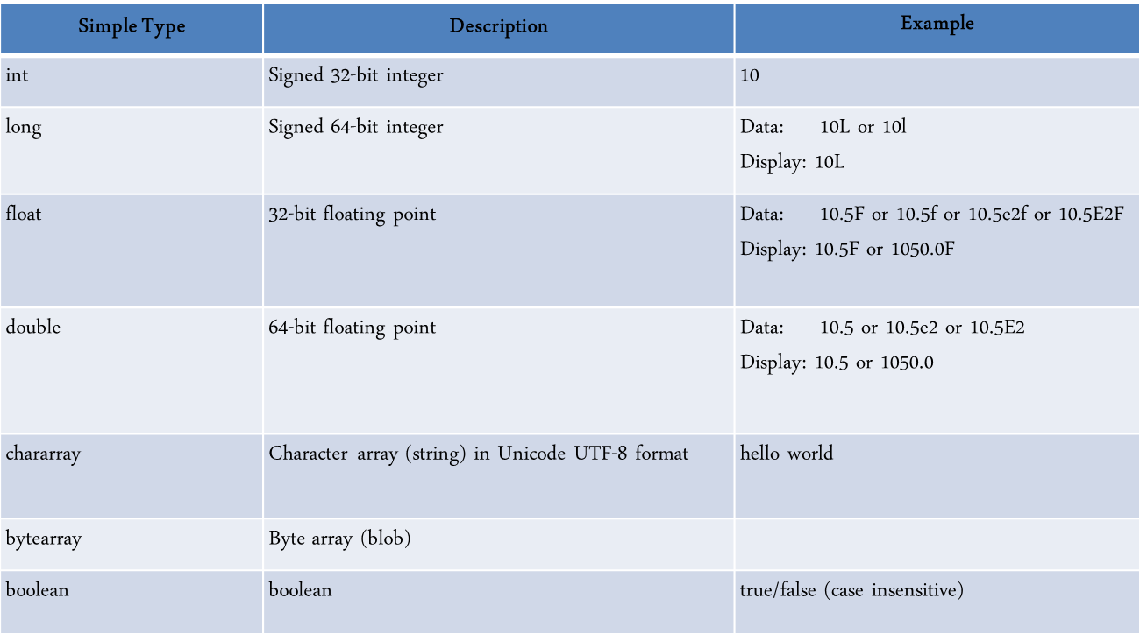
Simple Data Types

Slide 27
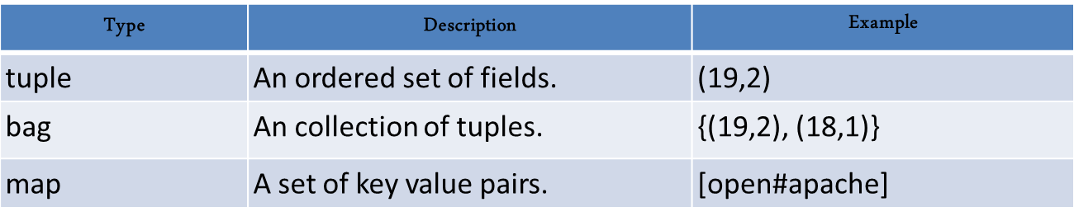
Complex Data Types
A tuple is a fixed-length, ordered collection of Pig data elements. Tuples are divided into fields, with each field containing one data element.
These elements can be of any type—they do not all need to be the same type. A tuple is analogous to a row in SQL, with the fields being SQL columns.
A bag is an unordered collection of tuples
A map in Pig is a chararray to data element mapping [key#value], where that element can be any Pig type, including a complex type.
The chararray is called a key and is used as an index to find the element, referred to as the value.

Slide 28
Expressions
Arithmetic | +, -, *, / | Add, subtract, multiply, divide
Modulo | x % y | Remainder of x divided by y
Comparison | == , != , < , > , <= , >= | Equal to, not equal to, greater than, less than, greater than or equal, less than or equal to
Null | x is null x is not null | Check if x has a value
Boolean | x and y x or y not x | Both x and y (are true) Either x or y (are true) Inverse of x
Cast | (t)x | Converts x to type t

Slide 29
Some Pig Functions
A number of built-in functions are provided:
AVG | Calculates average of numeric column
CONCAT | Concatenates two strings
COUNT | Counts the number of elements in a bag
DIFF | Takes two bags as arguments and compares them
MAX | Maximum value in a column
MIN | Minimum value in a column
SIZE | Number of elements based on the data type
SUM | Sum of numeric values
TOKENIZE | Splits string into a bag of words
IsEmpty | Determines if a Bag is empty

Slide 30
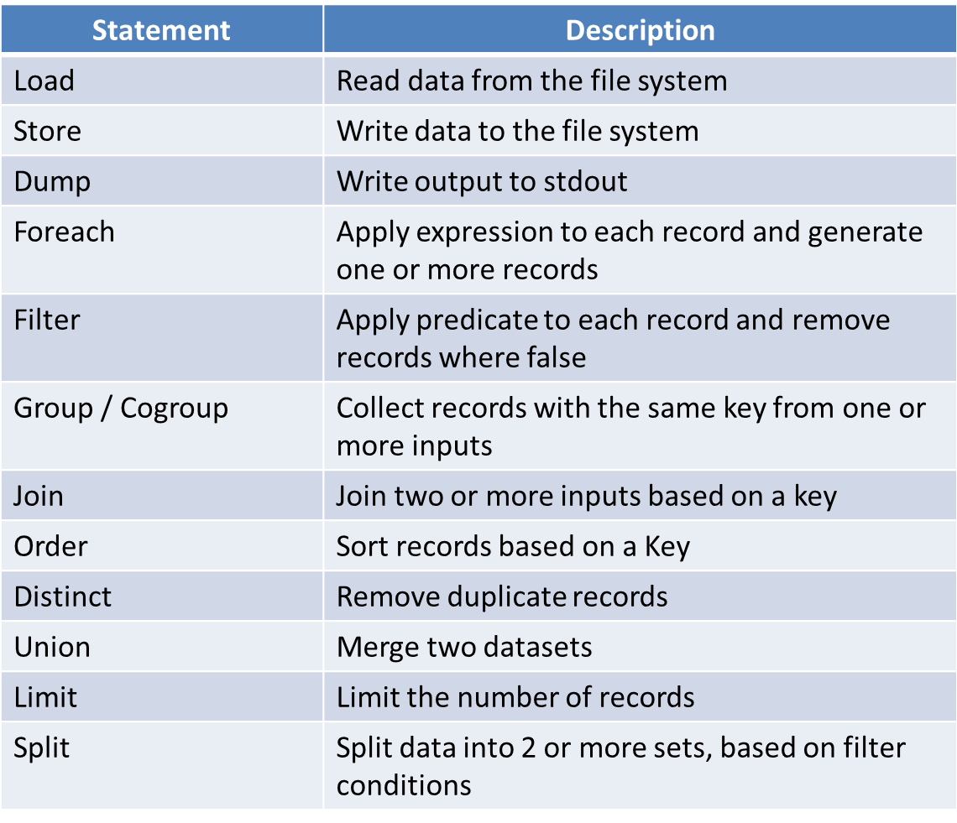
Pig Commands

Slide 31
Have Schema
Pig is lax towards schemas
User can provide a schema, but it is not essential
If no schema is provided Pig will guess a schema based on how the script treats the data
The easiest way to communicate the schema of your data to Pig is to explicitly tell Pig what it is when you load the data:
grunt> books = LOAD ‘books.csv’ USING PigStorage(‘,’) AS (ISBN:chararray, title:chararray, author:chararray, year:int, publisher:chararray, price:float);
Pig now expects your data to have six fields. If it finds more, it will ignore the extra ones. If it has less, it will pad the end of the record with nulls.
It is also possible to specify the schema without giving explicit data types. In this case, the data type is assumed to be bytearray:
grunt> books = LOAD ‘books.csv’ USING PigStorage(‘,’) AS (ISBN, title, author, year, publisher, price);

Slide 32
No Schema
In Pig it is possible to provide no schema at all
Fields can be referenced by name, and by position, starting from zero. The syntax is a dollar sign, then the position- $0 refers to the first field
Pig will not know the data type assumes everything is a bytearray
Then it looks at how you use those fields in your script, drawing conclusions about what you think those fields are and how you want to use them. Consider the following:
grunt> books = LOAD ‘books.csv’ USING PigStorage(‘,’);
grunt> price_in_pence = FOREACH books GENERATE UPPER($1), $5*100;
grunt> DUMP price_in_pence;
UPPER is a String function so Pig expects $1 (author) to be of type chararray
*100 implies an integer so Pig assumes $5 (price) to be an integer

Slide 33
Data Lake

Slide 34
What is Data Lake
A data lake is a central location in which to store all your data, regardless of its source or format at any scale
The data can be structured (relational), semi structured (non relational eg JSON) or unstructured.
It is often built using Hadoop and variety of storage and processing tools

Slide 35
Enterprise Data Warehouse (EDW)
Traditionally, an Enterprise Data Warehouse (EDW) has served as the foundation for business intelligence and data discovery.
Data flows into a data warehouse from transactional systems, typically RDBMS based, on a regular basis
Decision makers, Analysts, Data scientists access the data through Business Intelligence (BI) tools, SQL clients or other analytics applications

Slide 36
Limitations of Traditional Data Warehouse (TDW)
Data warehouse solutions not designed to handle the volume, variety, and complexity of today data.
Data sources are more numerous and varied resulting in more diverse data structures that must co-exist to enable analysis
Scaling up a conventional data warehouse to meet today increasing storage and workload demands is expensive, painful, and slow as it is typically vertical scaling (and not horizontal scaling)
Data Modelling can be complex. Need to understand the data first.
Need to decide which data to store and which data to ignore. A big effort is spent on deciding what to bring in, how to bring in, how to store, how to transform etc.
Lesser time is spent on actually performing data discovery, uncovering patterns

Slide 37
Difference between Data Lakes and Enterprise Data Warehouse (EDW)
EDW is fed data from variety of enterprise systems. The data needs to be transformed to conform to the EDW own predefined schema
Data lakes are fed information in its native form. Little or no processing is performed for adapting the structure to an enterprise schema
Data Lakes are Flexible - by allowing the data to remain in its native format, a far greater stream of data is available for analysis

Slide 38
Attribute | EDW | Data lake
Schema | Schema-on-write | Schema-on-read
Scale | Scales to large volumes at moderate cost | Scales to huge volumes at low cost
Access methods | Accessed through standardised SQL and BI tools | Accessed through SQL-like systems, programs created by developers, and other methods
Workload | Supports batch processing, as well as thousands of concurrent users performing interactive analytics | Supports batch and stream processing, plus an improved capability over EDWs to support interactive queries from users
Data | Cleansed | Raw
Cost/efficiency | Efficiently uses CPU/IO | Efficiently uses storage and processing capabilities at very low cost
Benefits | Data of recognised high value Known entities, tracked over time Transform once, use many Clean, safe, secure data Provides a single enterprise-wide view of data from multiple sources Easy to consume data High concurrency Consistent performance Fast response times | Candidate data of potential value Raw material for discovering entities and facts Transforms the economics of storing large amounts of data Scales to execute on tens of thousands of servers Enables analysis to begin as soon as the data arrives Allows usage structured /unstructured data from a single store Supports agile modeling by allowing users to change models, applications, and queries

Slide 39
Data Lake Characteristics - Ingest Data quickly
It ingests data quickly - A data lake ingests data in its raw, original state, straight from data sources, with little or no cleansing, standardisation or transformation
The early ingestion of data means that operational data is captured and made available for exploration, discovery, and reporting as soon as possible
It captures streaming or batch Data
Data is landed and ready for transformations prior to loading elsewhere.

Slide 40
Building a data lake - Start With a Business Problem
It is better you start with a business problem in mind, stay focused and solve it.
Customers who start with an actual business problem for their data lake are often more effective.

Slide 41
Building a data lake -Data Catalog
A key challenges in building a data lake is to keep track of all of the raw data as they were loaded into the data lake and then tracking all of the new data and versions that were created by data transformation, data processing, and analytics.
An essential component of a data lake is the data catalog. This provides a query-able interface of all data stored in the data lake
Data catalogs can alert users when data that is relevant to their work is ingested in the Data Lake
Example: AWS Glue, Azure Data Catalog

Slide 42
Building a data lake - Landing Zone
Landing zone is the central place where data will land in your enterprise. It contains all the raw data from all different source systems available. There is no cleansing and any logics applied on this layer
Hadoop is a useful to land data, for these reasons:
It can handle all kinds of data (structured or unstructured)
It is easily scalable and can store v large data volumes
It is inexpensive
Once you land data in Hadoop, you have the flexibility to query, analyse, or process the data in a variety of ways.

Slide 43
Building a data lake - Querying your archive
Several studies have shown that most data in an enterprise data warehouse is rarely used
An approach to address this inefficiency is to classify data as hot, warm, or cold; hot data is used often, warm data is used from time to time; and cold data is rarely used
Cold data could be archived to Hadoop

Slide 44
Building a data lake - Querying your archive (cont)
Key Hadoop technology you would use to perform the archiving is Apache Sqoop. This can move the data to be archived from the data warehouse into Hadoop.
Sqoop is a tool designed to transfer data between Hadoop and RDBMS. It can import data from relational databases such as Oracle, MySQL, SQL Server to Hadoop HDFS, and export from Hadoop file system to relational databases.

Slide 45
Building a data lake - Data pre-processing
Leverage the power of the Hadoop ecosystem to manipulate and apply transformations to data before it is loaded into a data warehouse eg Extract, Transform, Load (ETL) processes
ETL: Extract data from source database, Transform it into the form you need for your analysis and reporting system and then you Load this data into your target system eg data warehouse.
Having deployed a Hadoop based landing zone it can be used as a transformation engine. The landing data get its data from the transactional system into Hadoop using Sqoop and covers the extraction step.
Implement the transformation logic into MapReduce or Pig applications. After the data is transformed, you can load the data into the data warehouse using Sqoop.

Slide 46
Thanks!

